Slide 1
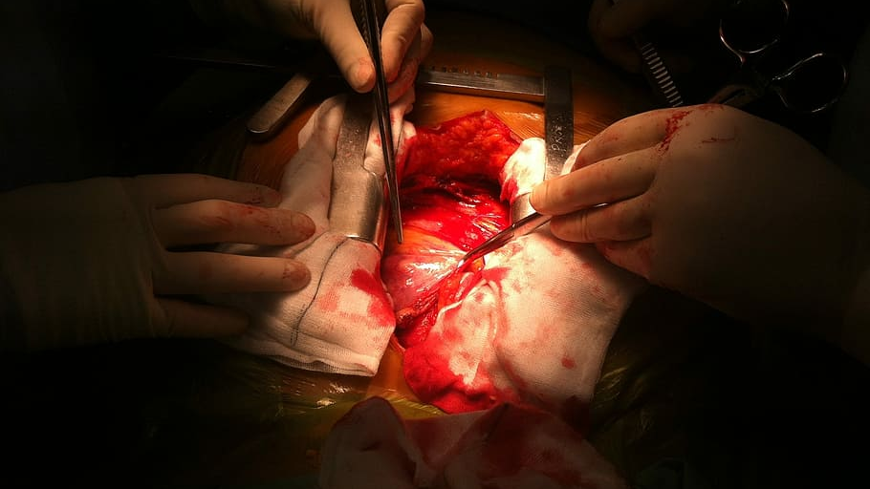
Heart Disease Prediction
Siphu Langeni, MS
02.20.2020

Slide 2
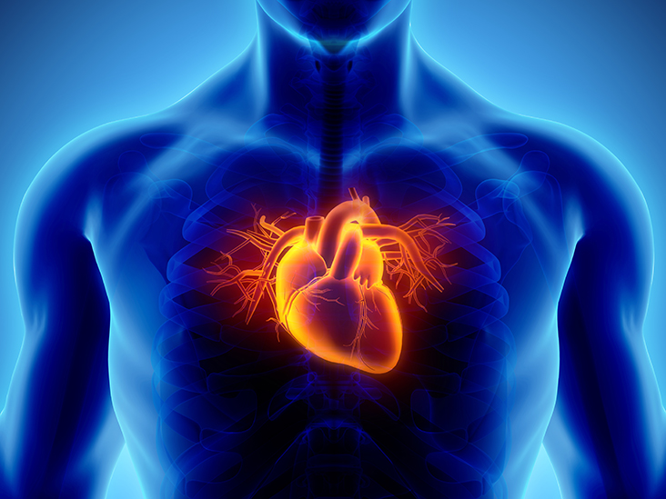
Objectives
Business Problem
Study Framework
Descriptive Analysis
Preliminary modelling
Summary
Q&A

Slide 3
Introduction to the Problem
World Health Organization says coronary artery disease (CAD) is the #1 killer for the last 15 years.
Affects approximately 17.9 million people worldwide.
Costs are tremendous
Quality/Loss of life
Burden on health care systems
Implore preventative strategies to mitigate costs to individuals and societies

Slide 4

The Study
Part of a larger longitudinal study (CORIS) originally published in South African Medical Journal in 1983 by Rousseauw, et al
Known high risk population of white, Afrikaaner males in a rural community in the Western Cape
462 participants aged 15 – 64

Slide 5
The Variables
Predictor Variables (X)
Target Variable (Y)
Modifiable
SBP (mmHg)
Tobacco Use (kg)
LDL Cholesterol (mmol/L)
Adiposity (% Bodyfat)
Obesity (kg/m²)
Alcohol Consumption
Non-modifiable
Family history
Type A Traits
Age of Onset
CAD
Positive (1)
Negative (0)

Slide 6
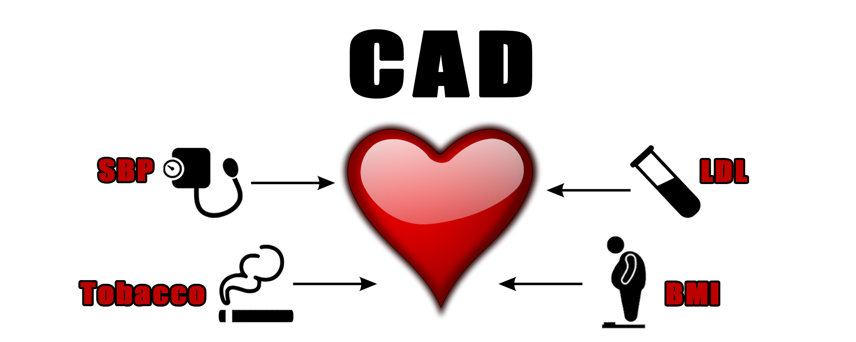
Study Framework

Slide 7

Hypotheses
Patients with sHTN will experience more CAD than those who are normotensive.
Patients with elevated LDL levels are at higher risk for CAD.
Patients who consume more tobacco products will have higher incidence of CAD.
Patients that are overweight or obese will have more CAD than those with normal and low BMI.

Slide 8
Frequency of CAD
302 (65.37%) negative
160 (34.63%) positive

Slide 9
Univariate Analysis

Slide 10

Transformation

Slide 11
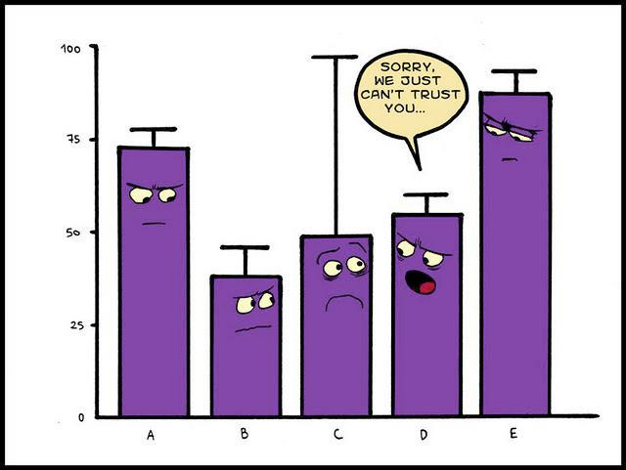
Outlier Analysis
Most of the data is right skewed. Outliers tend to be in the upper extremes.
Proc Univariate to identify 5 Number Summary
Upper limit = Q3 + 1.5(IQR)
Lower limit = Q1 – 1.5(IQR)
Once outliers are removed ,we are able to get a better distribution of the data

Slide 12
Bivariate Analysis

Slide 13

Two Sample T-Test
SBP
Mean_{CAD} = 143.7 mmHg
Mean_{noCAD} = 135.5 mmHg
p < 0.0001
Tobacco (transformed)
Mean_{CAD} = 1.5022 kg⁻³
Mean_{noCAD} = 0.9398 kg⁻³
p < 0.0001
LDL
Mean_{CAD} = 5.2800 mmol.L⁻¹
Mean_{noCAD} = 4.1505 mmol.L⁻¹
p < 0.0001
Obesity
Mean_{CAD} = 26.3017 kg.m⁻²
Mean_{noCAD} = 25.3975 kg.m⁻²
p 0.0088

Slide 14
χ² Analysis
SBP
SBP <= 120 mmHg = normotensive
SBP > 120 = hypertensive
p = 0.0379
Obesity
BMI < 25 = Under to Normal
BMI >= 25 = Overweight to Obese
p = 0.044

Slide 15
Scatterplot Matrix
Plot continuous data against other continuous data
Assess for multicollinearity between independent variables

Slide 16

Logistic Regression
Backward Feature Elimination
Features left (from framework)
Tobacco
LDL
Model concordance = 79.4 %
Odds ratio =
e ^ (-6.2288 + 0.5349(Tobacco_t) + 0.1508(LDL) − 0.4403(FH)+ 0.0367(Type A) + 0.0496(Age))

Slide 17
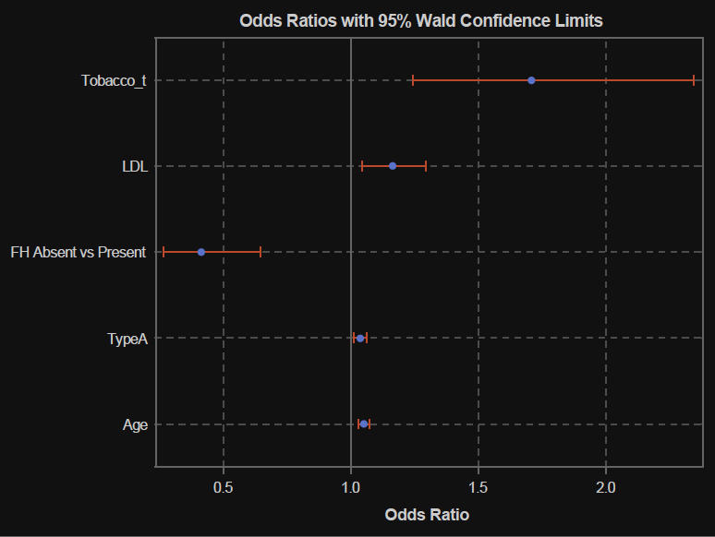
Odds Ratios
Tobacco
p = 0.0011
LDL
p = 0.0023
FH
p = <0.0001
Type A
p = 0.0016
Age
p = < 0.0001

Slide 18

Summary
Patients with sHTN will not experience more CAD than those who are normotensive.

Slide 19
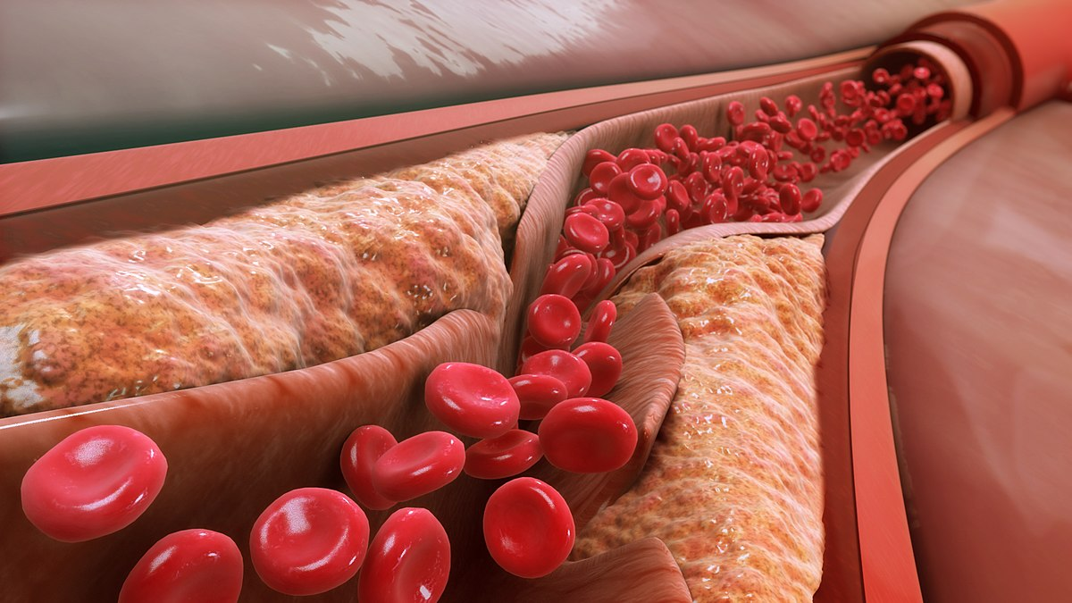
Summary
Patients with elevated LDL levels are at higher risk for CAD.

Slide 20

Summary
Patients who consume more tobacco products will have higher incidence of CAD.

Slide 21

Summary
Patients that are overweight or obese will have more CAD than those with normal and low BMI.

Slide 22
Summary
Logistic regression model indicates the most contributory variables in the study are:
Tobacco Use
LDL
Family History
Type A Traits
Age of Onset

Slide 23

Recommendations
Focus on preventative measures
Early identification
Patient education
Behavior modification
Medication

Slide 24

Thank you for your time!
Questions?

